Slide 1
Labor Market Overview
Current Labor Market Data and Impacts of COVID-19

Slide 2
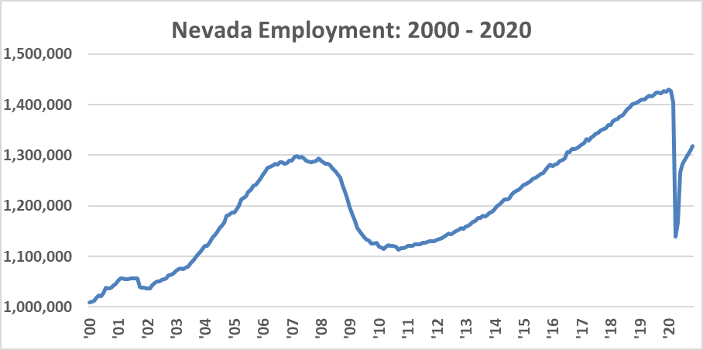
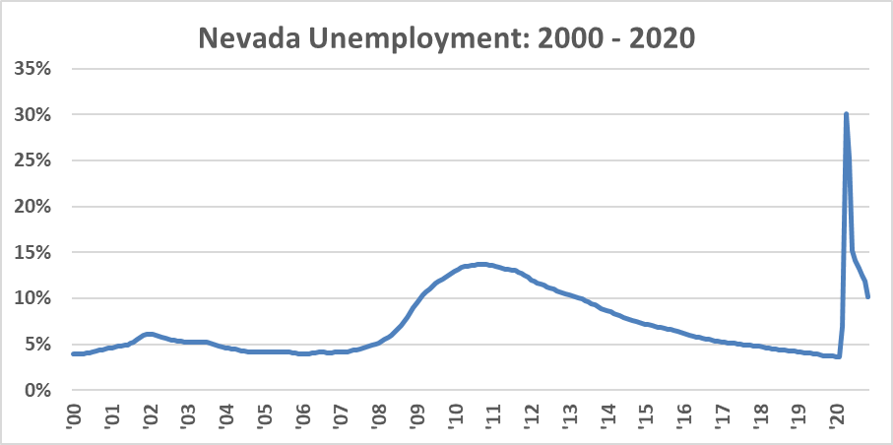
Current Data – November 2020
2
Employment: 1,503,339 → 1,139,000 → 1,317,800
Unemployment: 56,205 → 429,746 → 153,379
Unemployment Rate: 3.6% → 30.1% → 10.1%
Labor Force Participation Rate: 64.1% → 56.0% → 60.7%
Weekly Unemployment Claims*: 19,822 (UI) → 78,374 (UI) + 95,439 (PEUC) + 23,973 (SEB) + 78,804 (PUA) *Week Ending 12/26

Slide 3
High Unemployment: 2015-2019 Average
3
Most Current Data As Of: 2019 |  |  | Carson City | Churchill County | Clark County | Douglas County | Elko County | Esmeralda County | Eureka County | Humboldt County | Lander County | Lincoln County | Lyon County | Mineral County | Nye County | Pershing County | Storey County | Washoe County | White Pine County | Statewide | Southern Area | Northern Area
All Unemployed People, Orange Indicates High Unemployment Rate | Population | County Total: Ages 16+ | 1,382 | 667 | 70,969 | 942 | 1,291 | 12 | 0 | 299 | 231 | 148 | 1,810 | 194 | 1,535 | 170 | 52 | 12,984 | 128 | 92,814 | 72,664 | 20,150
 |  | County Total: Ages 20-64 | 1,030 | 579 | 61,135 | 795 | 1,042 | 7 | 0 | 288 | 212 | 117 | 1,359 | 186 | 1,200 | 161 | 43 | 10,600 | 105 | 78,859 | 62,459 | 16,400
 |  | County Total: Ages 25-64 | 725 | 385 | 50,157 | 710 | 954 | 7 | 0 | 254 | 144 | 92 | 1,224 | 159 | 974 | 161 | 21 | 8,416 | 107 | 64,490 | 51,230 | 13,260
 | Age | 16-19 | 254 | 63 | 7,359 | 79 | 208 | 0 | 0 | 14 | 20 | 32 | 274 | 9 | 149 | 10 | 0 | 1,925 | 14 | 10,410 | 7,540 | 2,870
 |  | 20-24 | 309 | 237 | 10,185 | 93 | 86 | 0 | 0 | 32 | 67 | 24 | 124 | 26 | 229 | 0 | 24 | 2,193 | 0 | 13,629 | 10,438 | 3,191
 |  | 25-29 | 82 | 110 | 9,386 | 88 | 108 | 4 | 0 | 51 | 25 | 0 | 351 | 27 | 72 | 46 | 0 | 1,634 | 9 | 11,993 | 9,462 | 2,531
 |  | 30-34 | 83 | 72 | 8,015 | 170 | 136 | 0 | 0 | 23 | 45 | 0 | 138 | 82 | 188 | 19 | 0 | 1,112 | 15 | 10,098 | 8,203 | 1,895
 |  | 35-44 | 217 | 23 | 13,243 | 131 | 302 | 0 | 0 | 66 | 47 | 31 | 232 | 20 | 147 | 42 | 12 | 1,637 | 54 | 16,204 | 13,421 | 2,783
 |  | 45-54 | 101 | 103 | 12,136 | 115 | 198 | 0 | 0 | 51 | 28 | 0 | 304 | 13 | 261 | 46 | 9 | 2,311 | 17 | 15,693 | 12,397 | 3,296
 |  | 55-59 | 191 | 59 | 4,824 | 153 | 110 | 3 | 0 | 27 | 0 | 30 | 88 | 7 | 200 | 8 | 0 | 998 | 11 | 6,709 | 5,057 | 1,652
 |  | 60-64 | 52 | 24 | 3,053 | 47 | 97 | 0 | 0 | 36 | 0 | 31 | 124 | 10 | 107 | 0 | 0 | 612 | 0 | 4,193 | 3,191 | 1,002
 |  | 65-74 | 73 | 26 | 2,509 | 59 | 36 | 5 | 0 | 0 | 0 | 0 | 136 | 0 | 156 | 0 | 8 | 472 | 7 | 3,487 | 2,670 | 817
 |  | 75+ | 11 | 0 | 579 | 10 | 1 | 0 | 0 | 0 | 0 | 0 | 33 | 0 | 22 | 0 | 0 | 62 | 0 | 718 | 601 | 117
 | Race / Ethnicity (Age 16 or Older) | White, Not Hispanic or Latino | 838 | 428 | 28,466 | 669 | 823 | 9 | 0 | 203 | 178 | 147 | 1,255 | 104 | 1,222 | 135 | 51 | 6,691 | 78 | 41,297 | 29,844 | 11,453
 |  | Black | 43 | 22 | 12,784 | 25 | 1 | 0 | 0 | 0 | 15 | 0 | 39 | 0 | 58 | 4 | 0 | 464 | 7 | 13,462 | 12,842 | 620
 |  | Hispanic | 320 | 21 | 20,169 | 215 | 278 | 3 | 0 | 49 | 37 | 0 | 364 | 10 | 133 | 23 | 0 | 4,353 | 0 | 25,975 | 20,305 | 5,670
 |  | American Indian & Alaska Native | 45 | 104 | 749 | 38 | 132 | 0 | 0 | 47 | 18 | 0 | 57 | 90 | 64 | 9 | 0 | 515 | 31 | 1,899 | 813 | 1,086
 |  | Asian | 15 | 31 | 5,738 | 0 | 0 | 0 | 0 | 0 | 0 | 0 | 11 | 0 | 10 | 0 | 0 | 616 | 0 | 6,421 | 5,748 | 673
 |  | Pacific Islander or Native Hawaiian | 0 | 0 | 736 | 0 | 0 | 0 | 0 | 0 | 0 | 0 | 10 | 0 | 0 | 0 | 0 | 49 | 0 | 795 | 736 | 59
 |  | Some Other Race | 237 | 0 | 7,762 | 28 | 68 | 0 | 0 | 11 | 0 | 0 | 153 | 0 | 70 | 20 | 0 | 1,554 | 0 | 9,903 | 7,832 | 2,071
 |  | Two or More Races | 11 | 63 | 3,926 | 6 | 56 | 0 | 0 | 2 | 0 | 0 | 135 | 0 | 59 | 0 | 0 | 801 | 10 | 5,069 | 3,985 | 1,084
 | Gender & Children (Age 20-64) | Male | 550 | 263 | 32,224 | 460 | 612 | 0 | 0 | 164 | 124 | 85 | 616 | 127 | 548 | 120 | 43 | 6,322 | 52 | 42,310 | 32,857 | 9,453
 |  | Female | 479 | 312 | 28,814 | 339 | 420 | 7 | 0 | 123 | 89 | 31 | 738 | 58 | 659 | 41 | 0 | 4,268 | 55 | 36,433 | 29,511 | 6,922
 |  | Female, With Children 0-17 | 123 | 89 | 9,205 | 104 | 173 | 0 | 0 | 18 | 87 | 0 | 184 | 6 | 131 | 29 | 0 | 1,423 | 54 | 11,626 | 9,336 | 2,290
 |  | Female, With Children 0-5 | 4 | 59 | 2,162 | 9 | 0 | 0 | 0 | 6 | 19 | 0 | 41 | 6 | 43 | 0 | 0 | 368 | 0 | 2,717 | 2,205 | 512
 |  | Female, With Children 0-5 & 6-17 | 46 | 15 | 2,420 | 20 | 64 | 0 | 0 | 10 | 45 | 0 | 93 | 0 | 0 | 0 | 0 | 422 | 25 | 3,160 | 2,420 | 740
 |  | Female, With Children 6-17 | 73 | 16 | 4,622 | 77 | 107 | 0 | 0 | 2 | 23 | 0 | 50 | 0 | 88 | 29 | 0 | 634 | 29 | 5,750 | 4,710 | 1,040
 | Education (Age 25-64) | Less than HS | 140 | 33 | 7,459 | 153 | 177 | 3 | 0 | 43 | 0 | 0 | 89 | 16 | 183 | 79 | 0 | 1,414 | 14 | 9,803 | 7,645 | 2,158
 |  | HS or equiv | 249 | 101 | 17,314 | 166 | 444 | 0 | 0 | 70 | 97 | 31 | 573 | 108 | 361 | 23 | 0 | 2,655 | 40 | 22,232 | 17,706 | 4,526
 |  | Some college or Associate deg | 221 | 172 | 17,131 | 255 | 258 | 4 | 0 | 123 | 48 | 30 | 442 | 21 | 405 | 47 | 13 | 2,572 | 27 | 21,769 | 17,570 | 4,199
 |  | Bachelor's degree or higher | 115 | 79 | 8,769 | 137 | 74 | 0 | 0 | 19 | 0 | 31 | 128 | 14 | 27 | 12 | 9 | 1,637 | 25 | 11,076 | 8,827 | 2,249
 | Poverty Status (Age 20-64) | Below poverty level | 203 | 107 | 20,264 | 188 | 392 | 0 | 0 | 147 | 36 | 4 | 390 | 41 | 710 | 47 | 0 | 3,274 | 43 | 25,846 | 20,978 | 4,868
 |  | At or above poverty level | 835 | 449 | 40,370 | 617 | 646 | 7 | 0 | 142 | 176 | 111 | 973 | 144 | 498 | 114 | 42 | 7,155 | 62 | 52,341 | 40,986 | 11,355
 | Other (20-64) | People with any disability | 282 | 40 | 6,985 | 81 | 136 | 0 | 0 | 32 | 12 | 27 | 125 | 3 | 280 | 0 | 0 | 1,108 | 29 | 9,140 | 7,292 | 1,848

Slide 4
High Unemployment: 2015-2019 Average
4
This data is not current, but it is the most recent data available. Getting data by county requires use of the American Community Survey, which uses a five-year average to report on smaller areas of the state.
These figures represent long-term structural issues. While almost all groups have at least one county where that group has high unemployment, the highlighted groups have more consistently high unemployment, counted in a couple ways:
A large number of counties (>10 highlighted)
A large number of the unemployed captured (> 90% in red, > 80% light orange, > 15% light yellow)
2015-2019 Average |  | Number of Counties | Share of Demographic Unemployment Affected
Age | 16-19 | 14 | 100%
 | 20-24 | 9 | 98%
 | 25-29 | 6 | 83%
 | 30-34 | 5 | 5%
 | 35-44 | 1 | 0%
 | 45-54 | 1 | 0%
 | 55-59 | 3 | 3%
 | 60-64 | 1 | 1%
 | 65-74 | 3 | 5%
 | 75+ | 2 | 8%
Race / Ethnicity (Age 16 or Older) | White, Not Hispanic or Latino | 2 | 3%
 | Black | 6 | 99%
 | Hispanic | 4 | 18%
 | American Indian & Alaska Native | 13 | 100%
 | Asian | 1 | 0%
 | Pacific Islander or Native Hawaiian | 2 | 94%
 | Some Other Race | 3 | 18%
 | Two or More Races | 6 | 98%
Gender & Children (Age 20-64) | Male | 5 | 17%
 | Female | 4 | 4%
 | Female, With Children 0-17 | 3 | 1%
 | Female, With Children 0-5 | 4 | 84%
 | Female, With Children 0-5 & 6-17 | 7 | 99%
 | Female, With Children 6-17 | 2 | 1%
Education (Age 25-64) | Less than HS | 10 | 98%
 | HS or equiv | 8 | 97%
 | Some college or Associate deg | 1 | 1%
 | Bachelor's degree or higher | 2 | 0%
Poverty Status (Age 20-64) | Below poverty level | 14 | 100%
 | At or above poverty level | 0 | 0%
Other: (20-64) | People with any disability | 8 | 97%

Slide 5
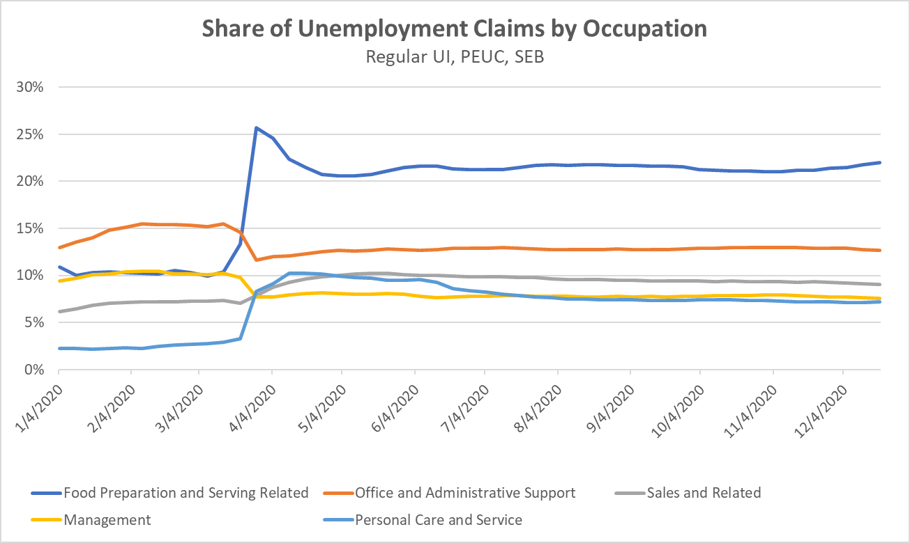
COVID Impacts – By Occupation
5

Slide 6
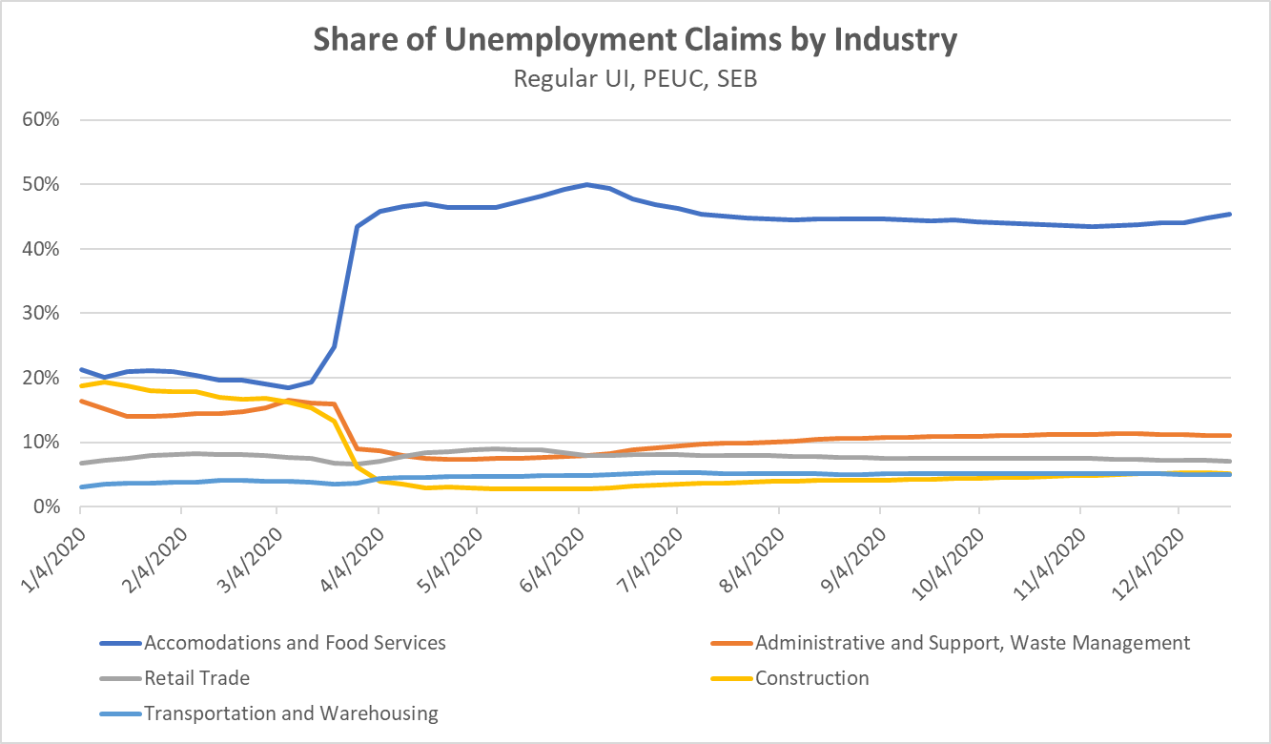
COVID Impacts – By Industry
6

Slide 7
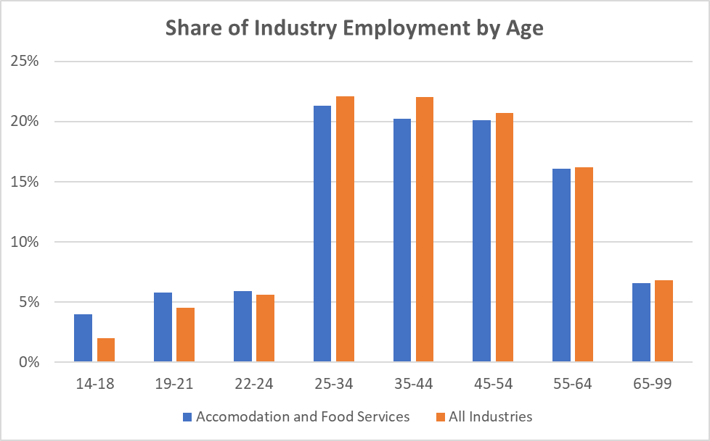
COVID Impacts – A&FS By Age
7

Slide 8
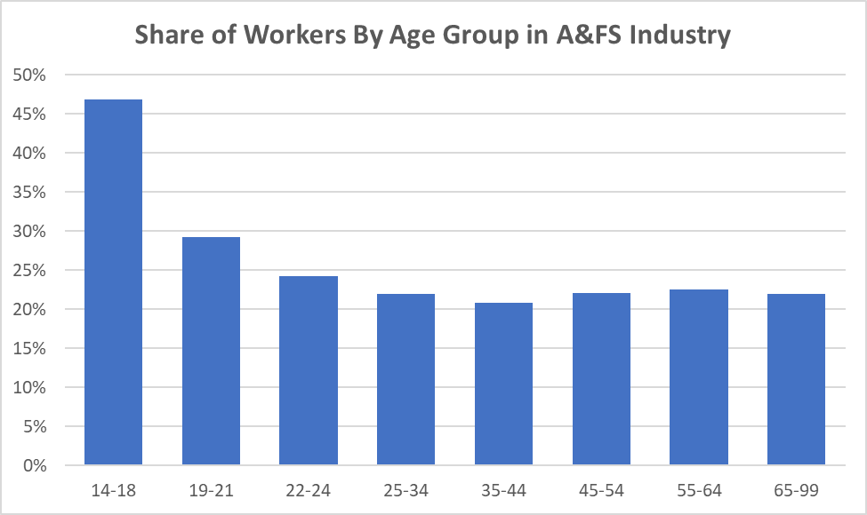
COVID Impacts – Age in A&FS
8

Slide 9
For Additional Information, Please Contact
David Schmidt
Chief Economist
deschmidt@detr.nv.gov
Christopher Robison
Supervising Economist
c-robison@detr.nv.gov
(775) 684-0450
detrlmi@detr.nv.gov
http://www.nevadaworkforce.com

